Slide 1

Presentation to
SUPERSTORE EXPLORATIVE DATA ANALYSIS
By :
PETER MUHIA
Class: dfs-DPTO4
Date: Monday 24th 2023

Slide 2
PROJECT OBJECTIVES
Time Series Analysis to evaluate the trends in superstore sales, profit, or discount between 2014 and 2017
To analyze trend in total sales per state
To anlyze market segments
To determine the relationship between discount and profit..

Slide 3
Descriptive statistics
Postal Code | Sales | Quantity | Discount | Profit
count | 9994.000000 | 9994.000000 | 9994.000000 | 9994.000000 | 9994.000000
mean | 55190.379428 | 229.858001 | 3.789574 | 0.156203 | 28.656896
std | 32063.693350 | 623.245101 | 2.225110 | 0.206452 | 234.260108
min | 1040.000000 | 0.444000 | 1.000000 | 0.000000 | -6599.978000
25% | 23223.000000 | 17.280000 | 2.000000 | 0.000000 | 1.728750
50% | 56430.500000 | 54.490000 | 3.000000 | 0.200000 | 8.666500
75% | 90008.000000 | 209.940000 | 5.000000 | 0.200000 | 29.364000
max | 99301.000000 | 22638.480000 | 14.000000 | 0.800000 | 8399.97600

Slide 4
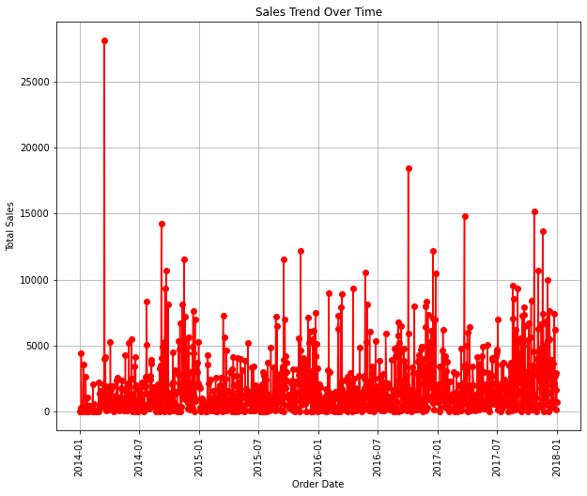
Sales trend

Slide 5
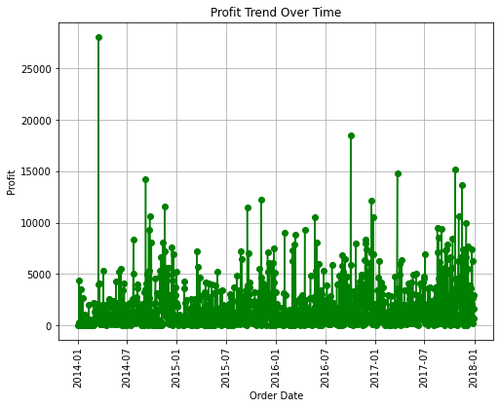
Profit trend

Slide 6
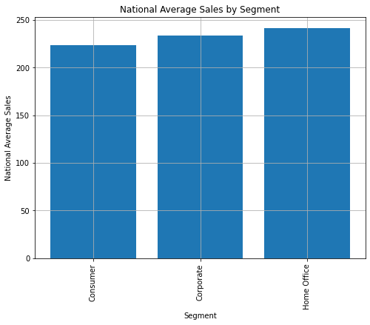
National Average sales by segment

Slide 7
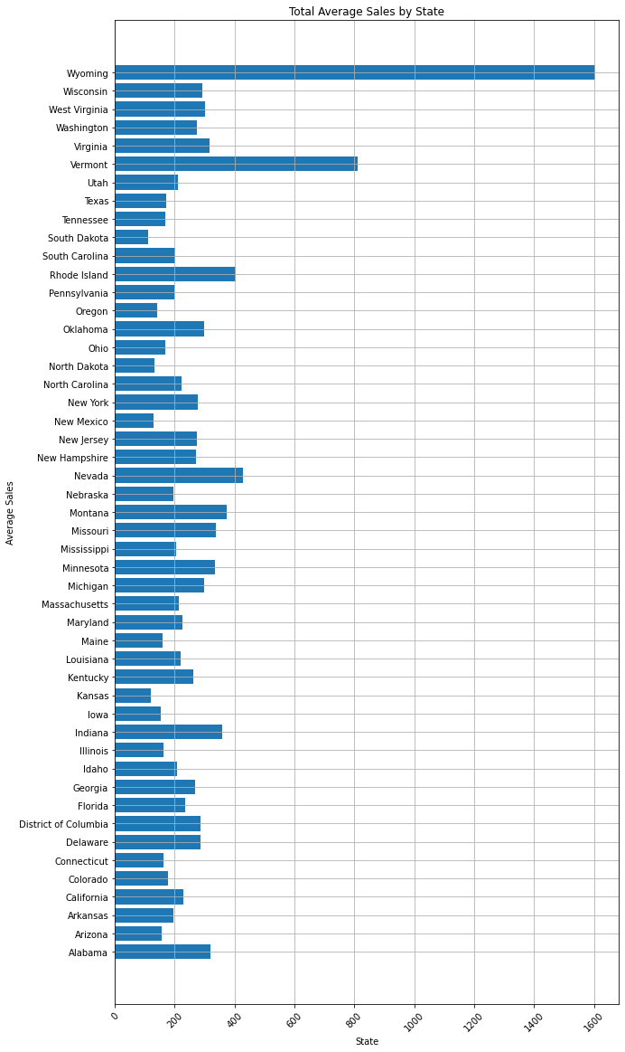
Total Average Sales by state

Slide 8
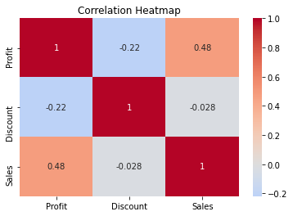
Correlation

Slide 9
Conclusion
Discount, sales and profit in the superstore follow same trends under the review period
Wyoming command the largest market share followed by Vermont and Nevada states
South Darkota and Kansas has the least market share
Home office remain the largest market segnment although the difference with consumer and corporate segments is marginal
Discount offered appear to depress both profit and sales

Slide 10
THANK YOU!

Slide 11
Recommendations
There is potential to improve market share of South Darkota and Kansas and 12 other states to about average market share
Market penetration strategies and cost leadership in these states is highly recommended
There is need to promote all customer segments as they appear to have equal potential
Discount offered in all the areas need to be eliminated as its appear to affect the business sales and profits negatively.
Alternatively, the superstore need to consider havong more targeted discounts for specific products and specific states

